Slide 1

University of North Texas – EENG
Final Project
EENG 2910: Project III – Digital System Design
Team: No Name Blue
Yang Qi
Nathan Ruprecht
Ayodele Ojo
Maher Alsanwi
A Green Light to Greatness

Slide 2
Overview
Project Requirements
Architecture
State Machine
Our Solution
Demonstration
References
Workload Split
A Green Light to Greatness

Slide 3

Project Requirements
8-bit Processor (CPU)
4, 4-bit registers (Register File)
Memory with 8-bit words (ROM)
ALU
Out on LEDs or Seven Segment display
Add, subtract, shift, and compare
3 types of instructions
Data handling and manipulation
Branch instruction
Input/Output
A Green Light to Greatness

Slide 4
Architecture
A Green Light to Greatness

Slide 5
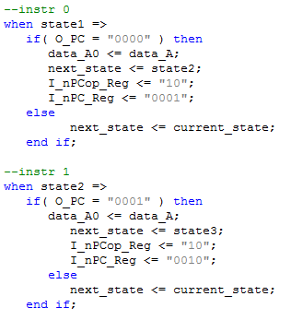
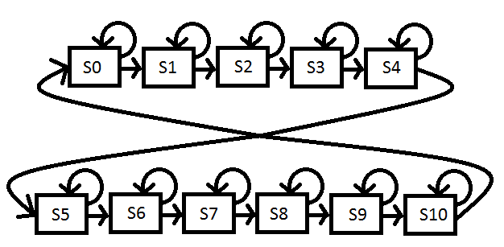
State Machine
Mealy vs Moore State Machine
A Green Light to Greatness

Slide 6
Our Solution – ALU
A Green Light to Greatness

Slide 7
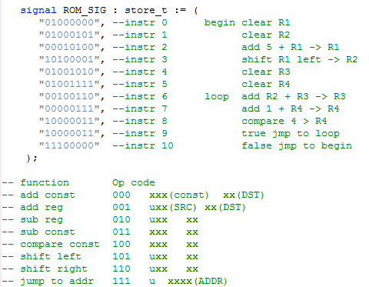
Our Solution – PC/ROM
A Green Light to Greatness

Slide 8
Our Solution – RF
A Green Light to Greatness

Slide 9
Our Solution – Implementation
A Green Light to Greatness

Slide 10
Demo
A Green Light to Greatness

Slide 11
References
A Green Light to Greatness

Slide 12
Workload Split
A Green Light to Greatness

Slide 13
Summary
Project Requirements
Architecture
State Machine
Our Solution
Demonstration
References
Workload Split
A Green Light to Greatness

Slide 14

Questions?
A Green Light to Greatness

